Slide 1
Universal Approximation
Implementation on a qubit

Slide 2
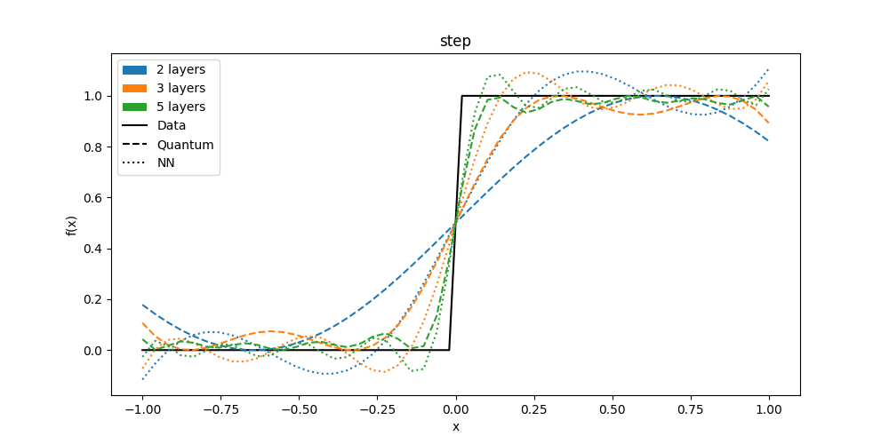
Step function

Slide 3
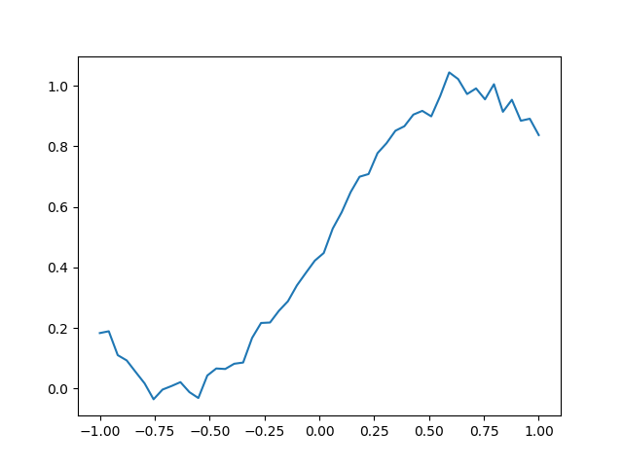
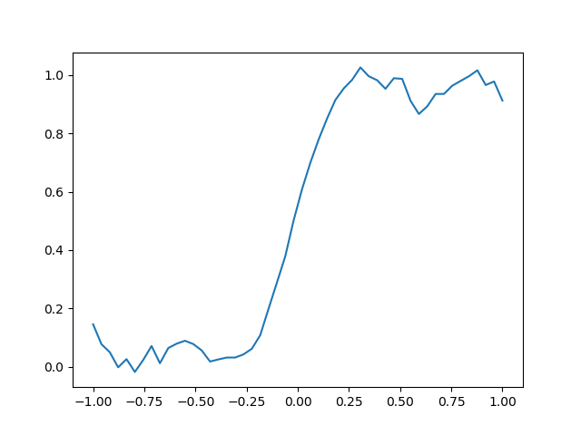
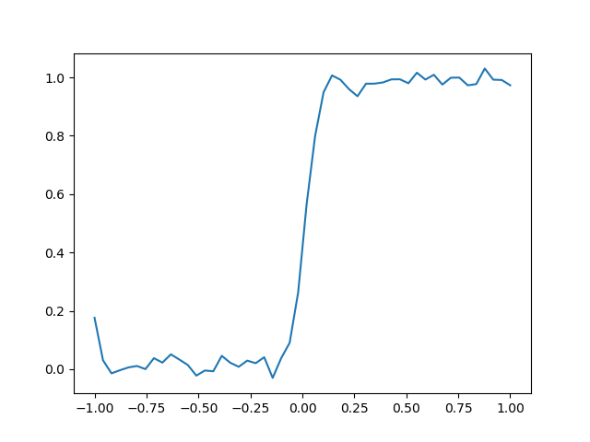
Step function - Experiment
2 LAYERS
3 LAYERS
5 LAYERS

Slide 4
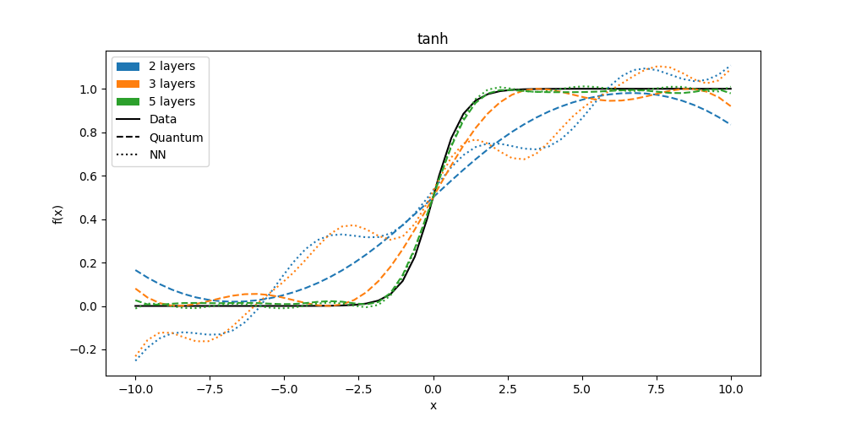
Tanh function

Slide 5
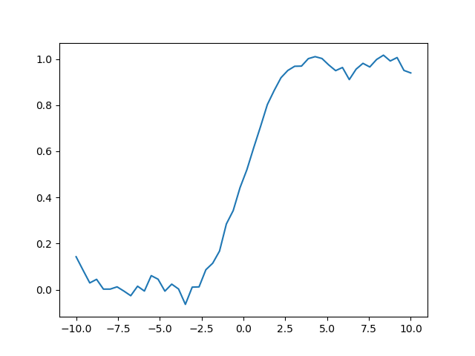
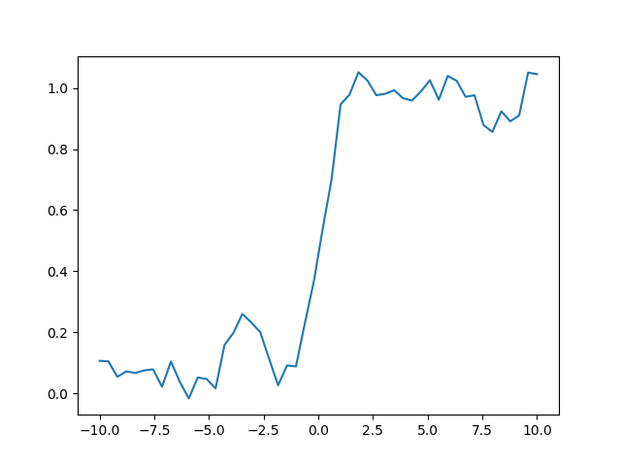
Tanh function - Experiment
3 LAYERS
5 LAYERS

Slide 6
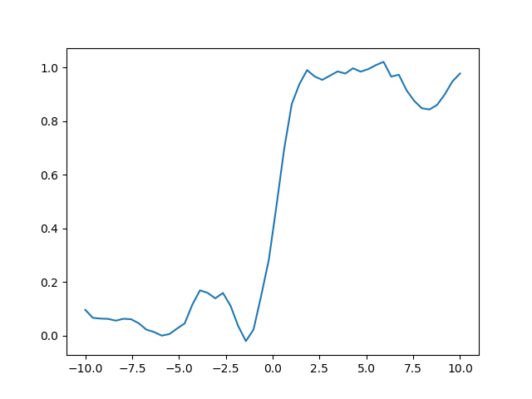
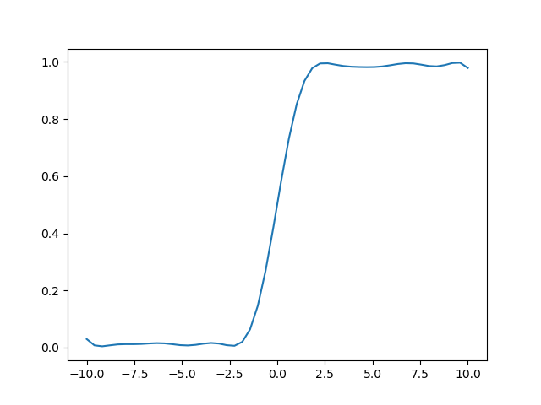
Tanh function – Experiment 5 layers
Default trial
More averages
Simulation no noise

Slide 7
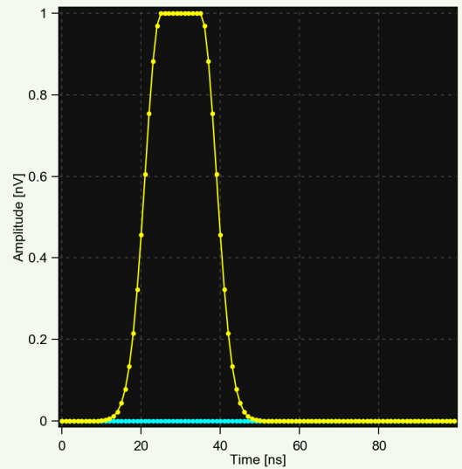
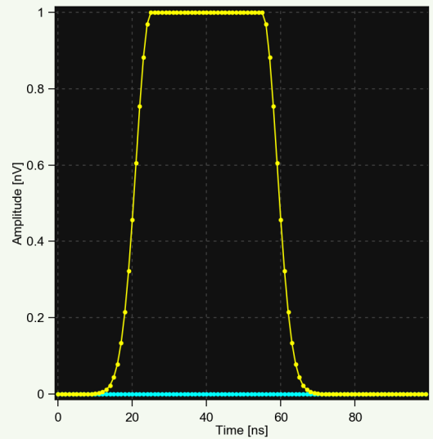
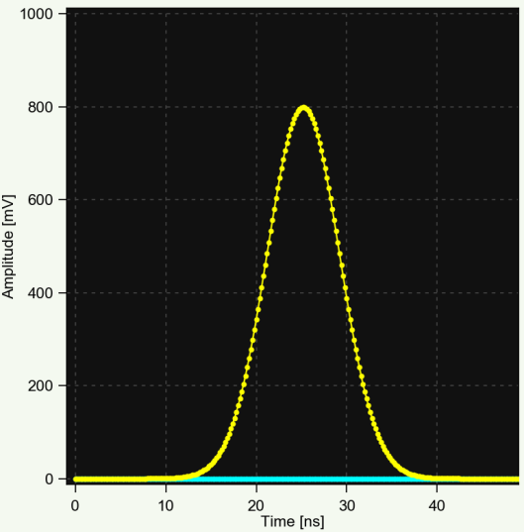
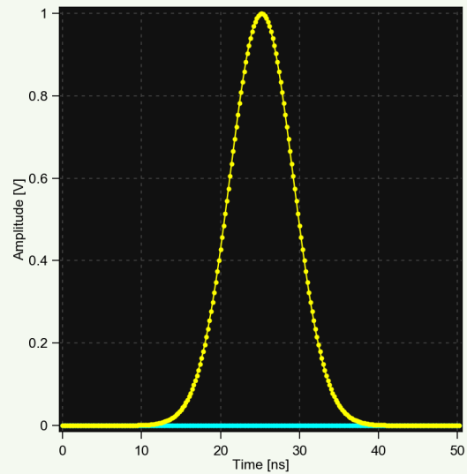
Pulse Generation
Time-modulated
Amplitude-modulated

Slide 8
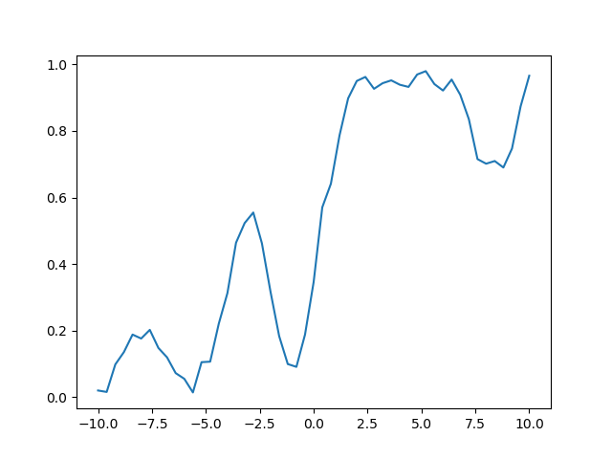
New pulses

Slide 9
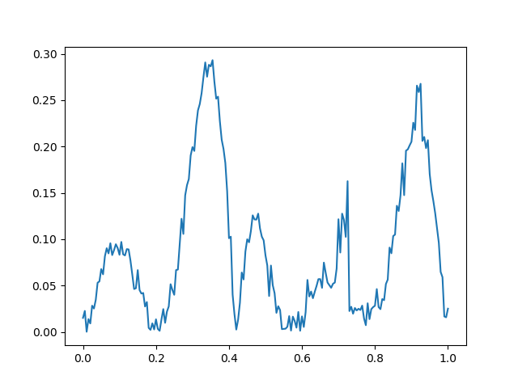
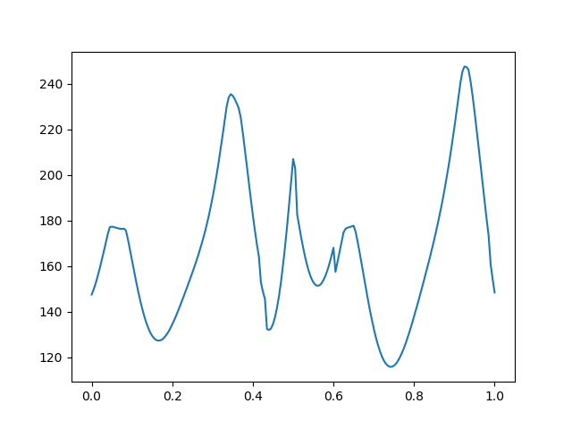
Sequence analysis
Difference between simulation and experiment
Time around equator

Slide 10
What to do?
Work on our pulses:
Characterize phase errors
Apply DRAG (Derivate Reduction by Adiabatic Gate)
Apply reset protocol to sequences
Predistort pulses
Divide every pulse on two Xpi/2 and Z rotations
Perform the training on the qubit

